Slide 1
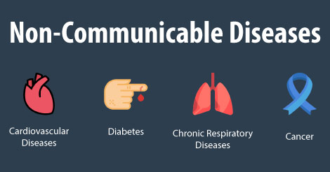

Centre For Health
Ishtiaq Hussain

Slide 2
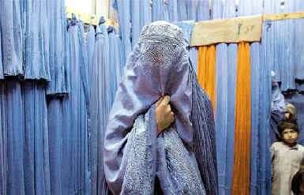
Meet Wazeera from My Hometown
45 years old diabetes patient
Doctors recommended that she should perform aerobic exercise regularly. Aerobic activity bouts should ideally last at least 10 min, with the goal of ∼30 min/day or more, most days of the week for adults with type 2 diabetes.
But limited opportunities, restrictions on going outside of homes, culture and religion not allow her physical activities in her village.
She and several other placing them at increased risk of non-communicable diseases (NCDs) including diabetes, heart disease and cancer

Slide 3
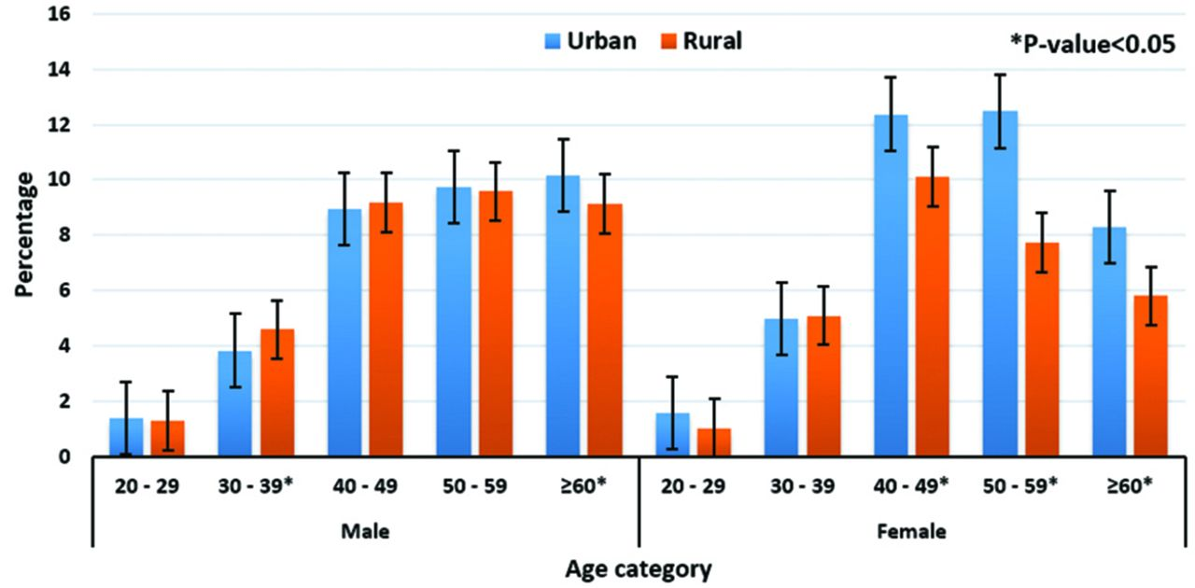
Background and Rationale
Non-communicable diseases (NCDs) rates in Pakistan are significantly on the rise
A growing middle-income population of young women in Pakistan rural areas experience limited opportunities for physical activity.
Diabetes affects around 17 to 19pc of Pakistanis, with approximately 35.3 million diabetics, or one out of six of the adult population of the country.
Dawn 2018 Report
Problem of Focus
A growing middle-income population of young women in my hometown experience limited opportunities for physical activity placing them at increased risk of non-communicable diseases (NCDs) including diabetes, heart disease and cancer..

Slide 4






Our Solution:
What is it? WhatsApp Chatbot channel run by women, for women to provide free convenient fitness classes in Pashto through a train-the-trainer model in Parachinar.
What does it do? Daily send a fitness video by WhatsApp chatbot channel directly to a women by female instructors.
How does it work?

Slide 5




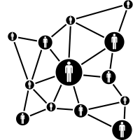



Call To Action
Our Goal: Easy way to teach women, Moms into Fitness is here to help women achieve their fitness goals and prevent them from non-communicable diseases (NCDs.
Our Strategy: We have plan to Initial operate it Parachinar tribal area with the support of Seed Money/Donor to launch Proof of Concept.
Our Need: Networks | Partnerships |
Operational Funding | Ambassadors
We will provide you Accountability and Quality

Slide 6
Why we deserve your support?
Addresses crucial scale of non-communicable diseases (NCDs in Parachinar with a model scalable to other rural areas of Pakistan.
Simple solution and high value
Skilled, experienced and comitted team
Competitive Advantage
Unfortunately in Pakistan there are no similar solution do parts of what we project to do. It will be the first whatsapp chatbot in local language Pashto for women fitness classes.

Slide 7

“And I believe that the best buy in public health today must be a combination of regular physical exercise and a healthy diet.” – Julie Bishop
Thank You :)
Ishtiaq Hussain | Centre for Health

